Slide 1
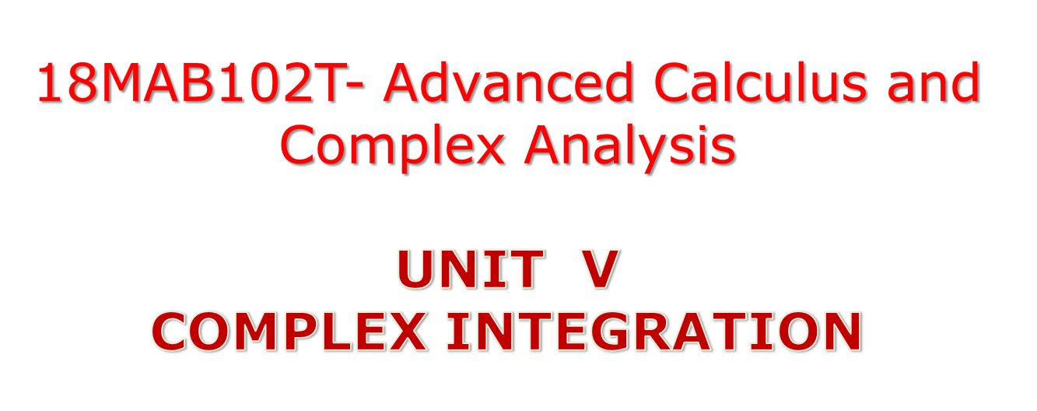

Slide 2

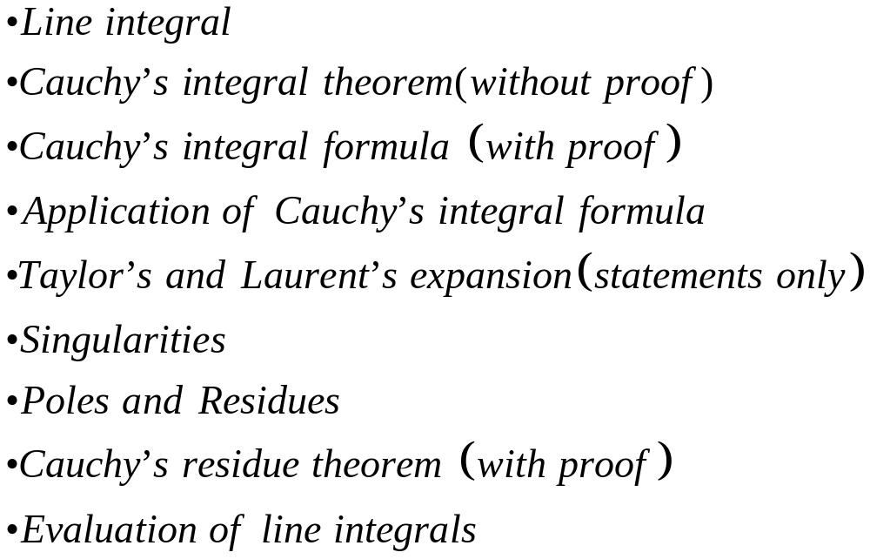

Slide 3
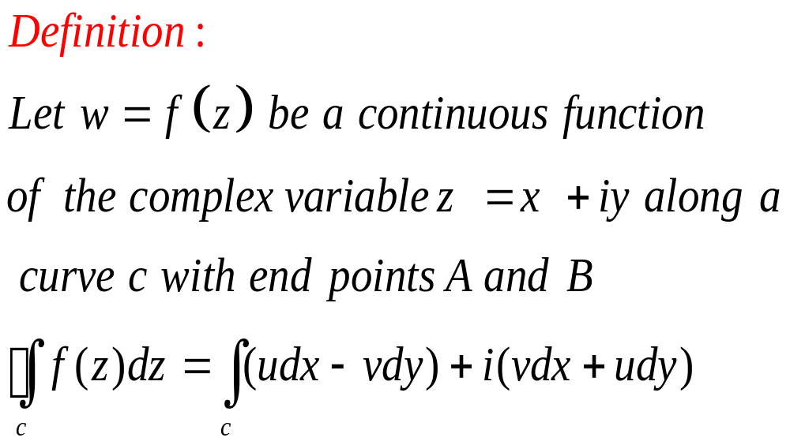
LINE INTEGRAL

Slide 4
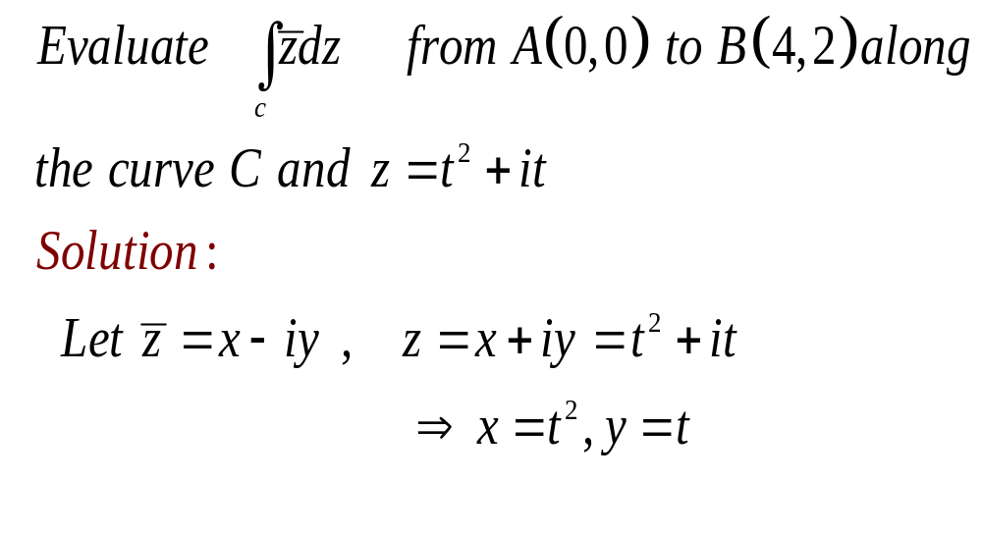
EXAMPLE

Slide 5
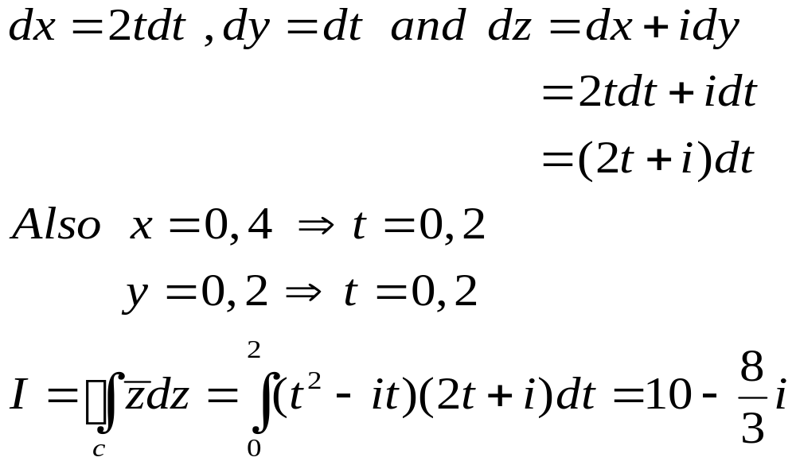
then,

Slide 6
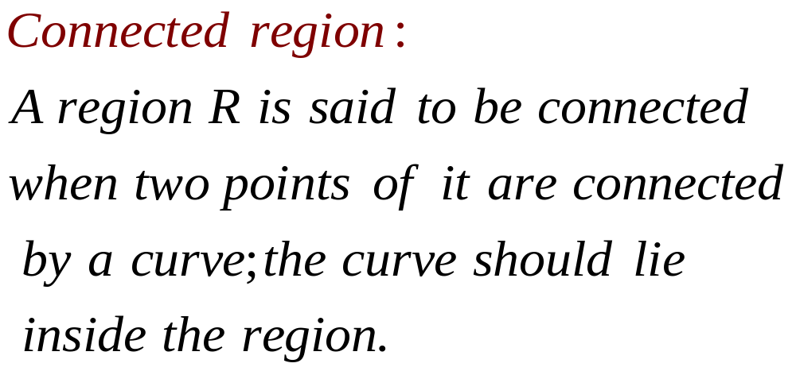
DEFINITIONS

Slide 7
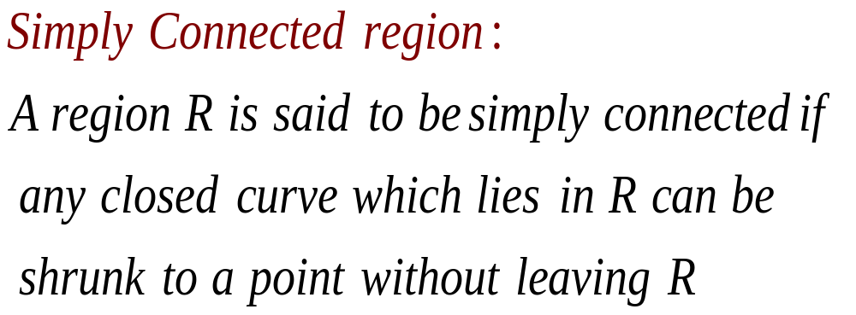

Slide 8
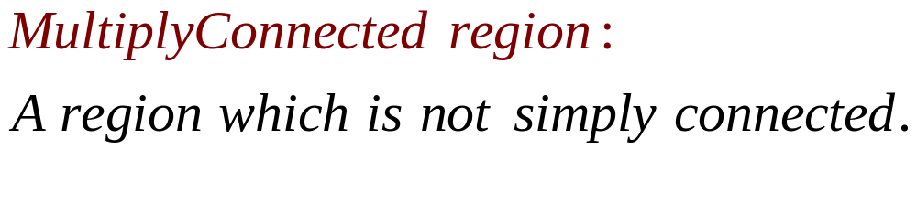
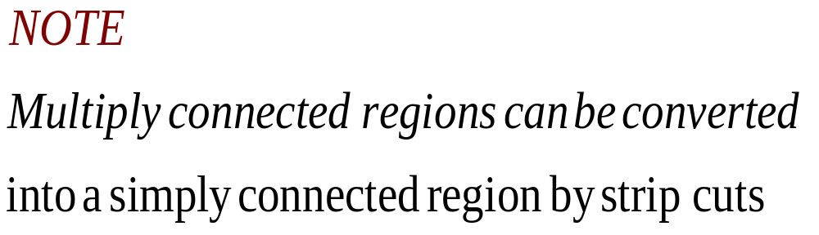

Slide 9
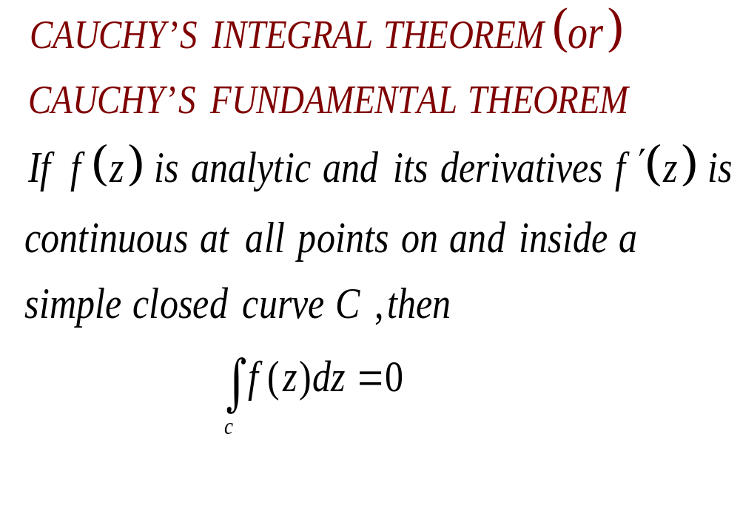

Slide 10
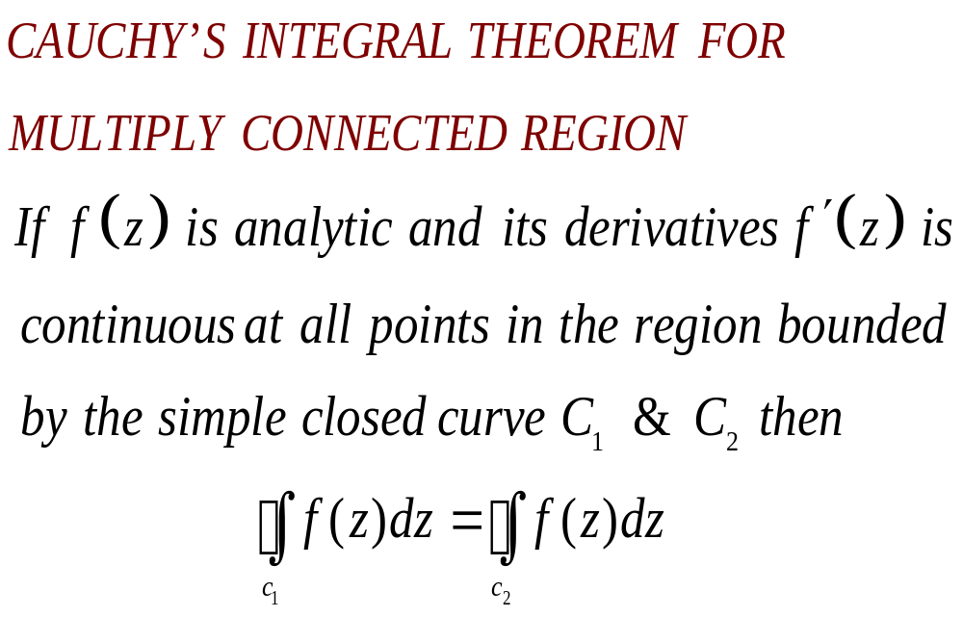

Slide 11
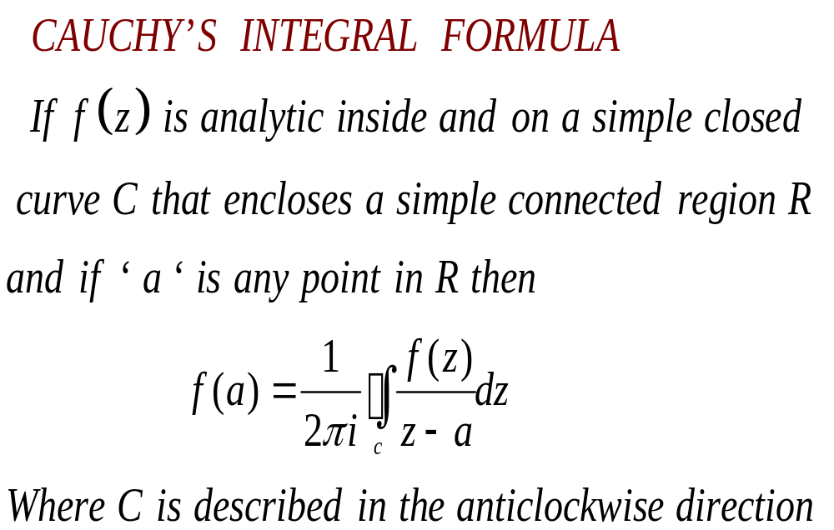

Slide 12
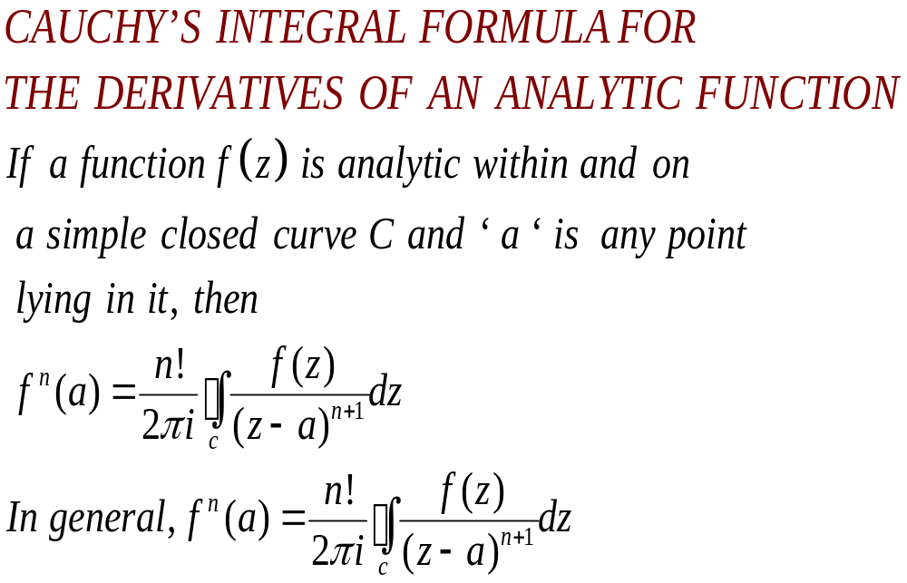

Slide 13
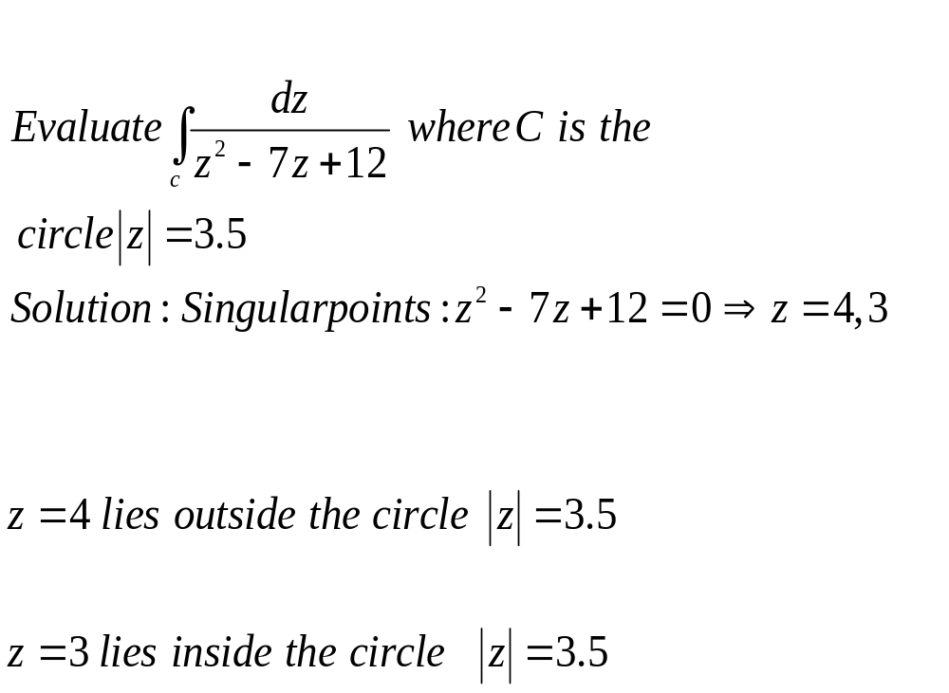
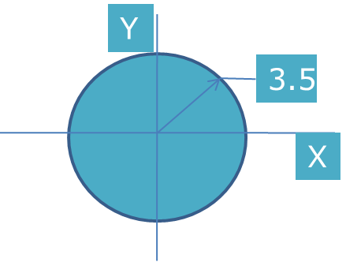
EXAMPLES 1

Slide 14
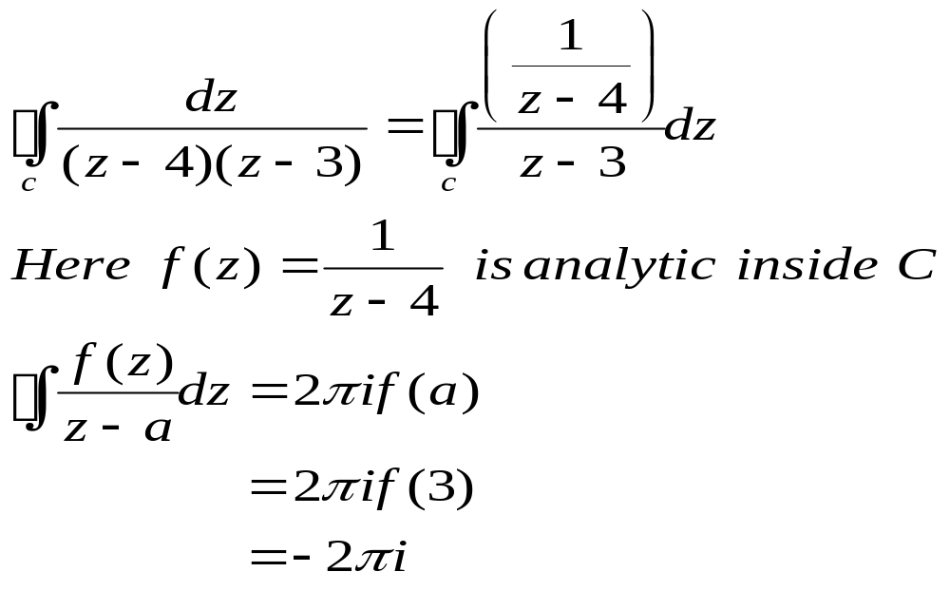

Slide 15
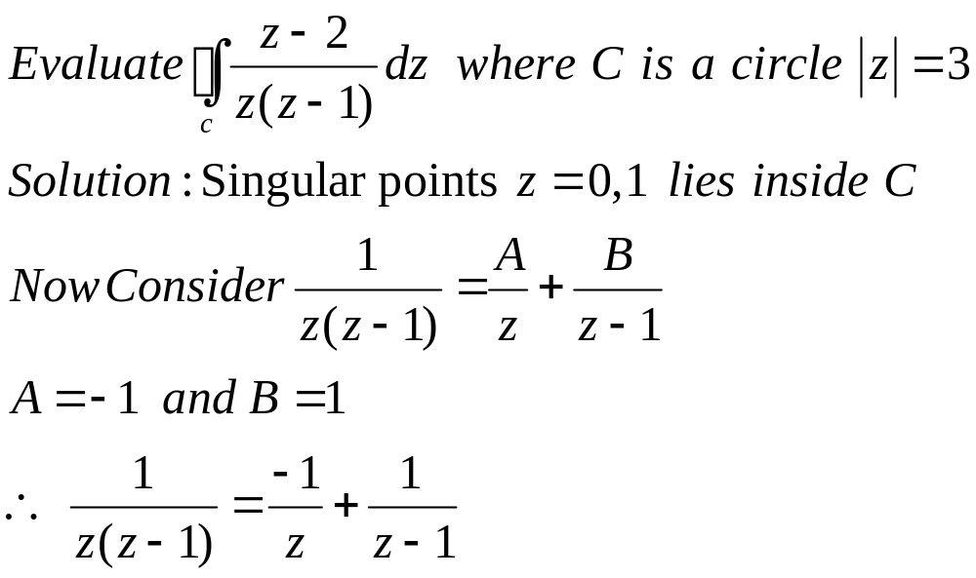

EXAMPLES 2

Slide 16
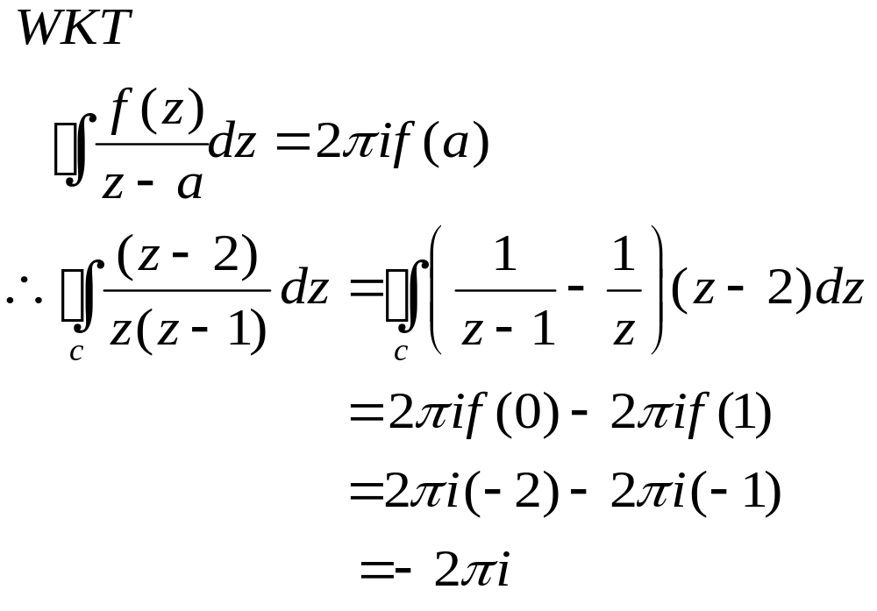

Slide 17
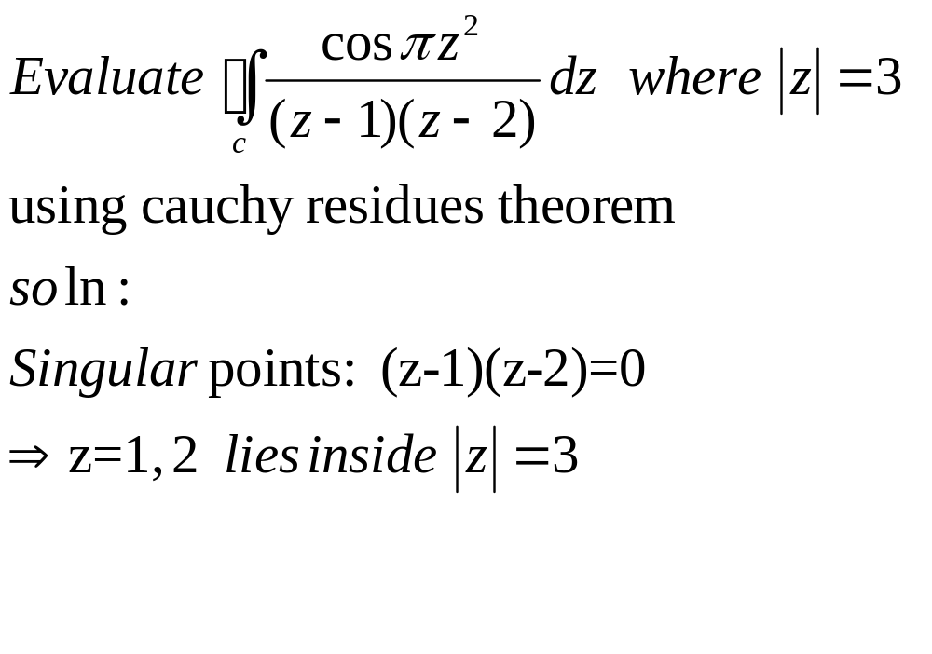
EXAMPLES 3

Slide 18
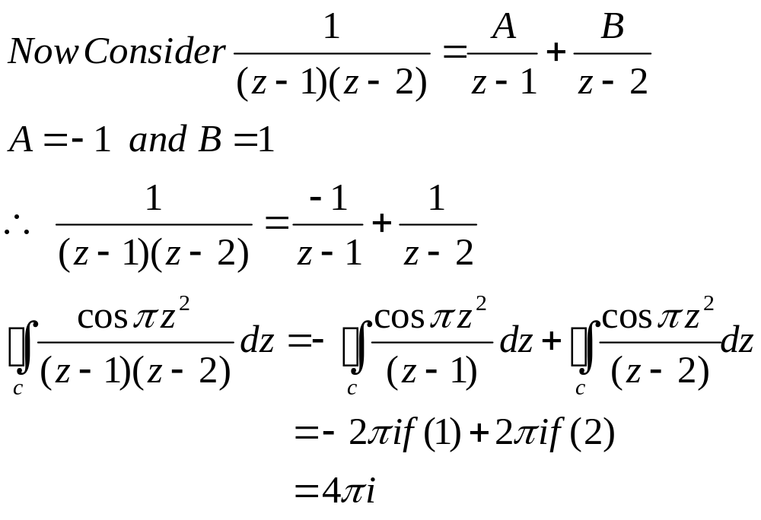

Slide 19
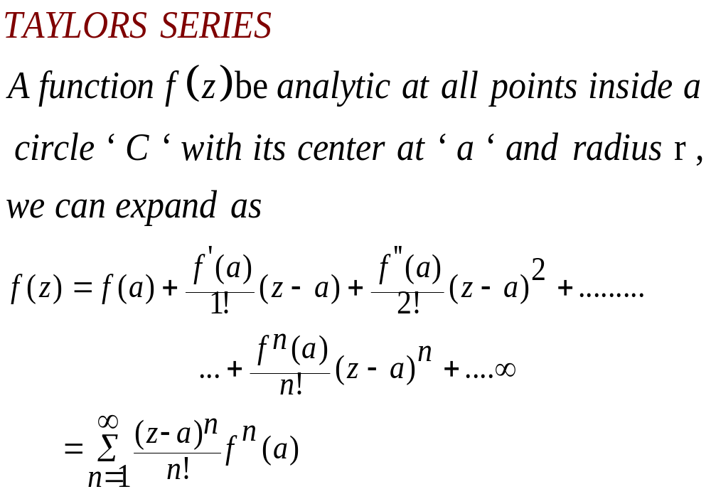

Slide 20
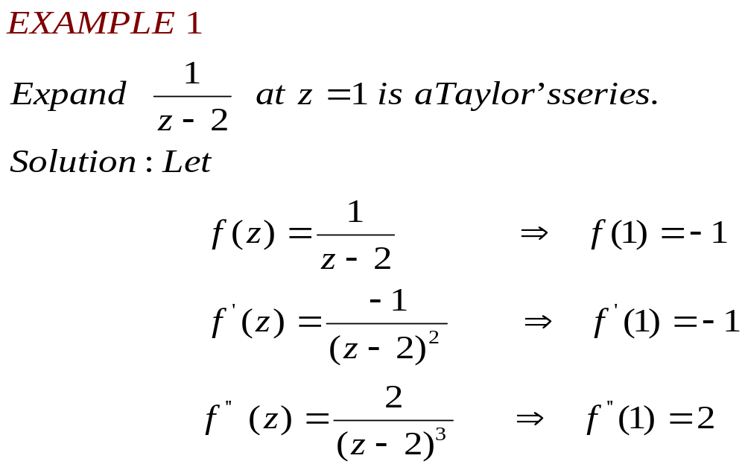

Slide 21
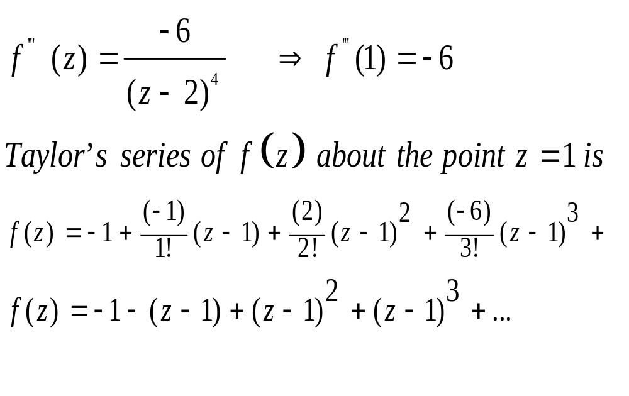

Slide 22
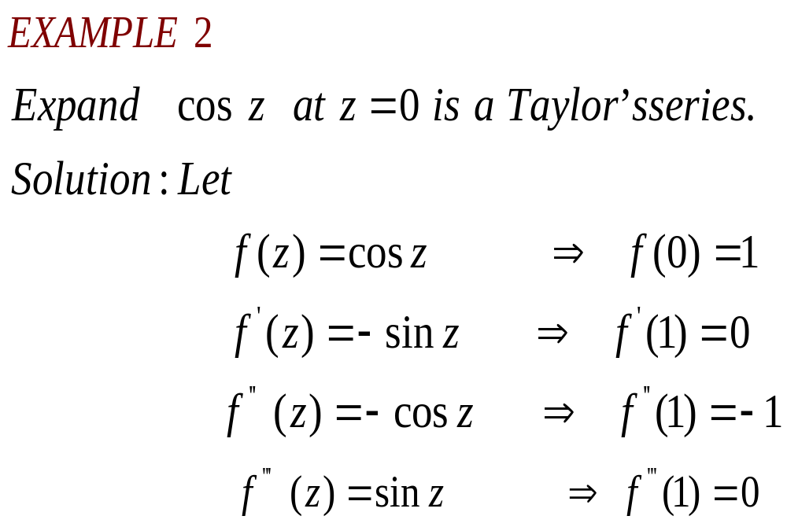

Slide 23
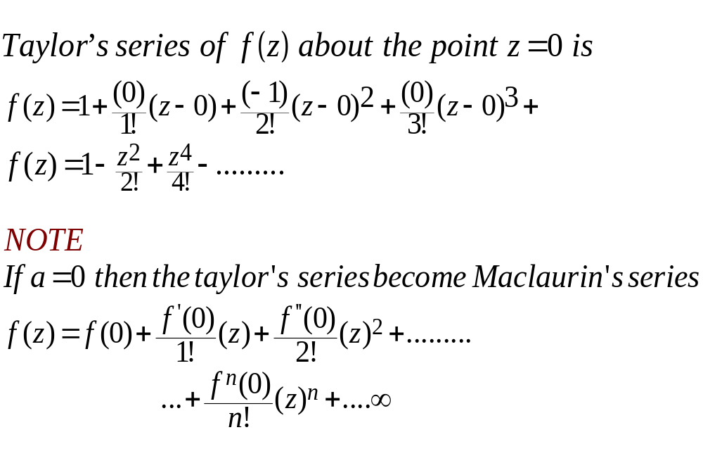

Slide 24
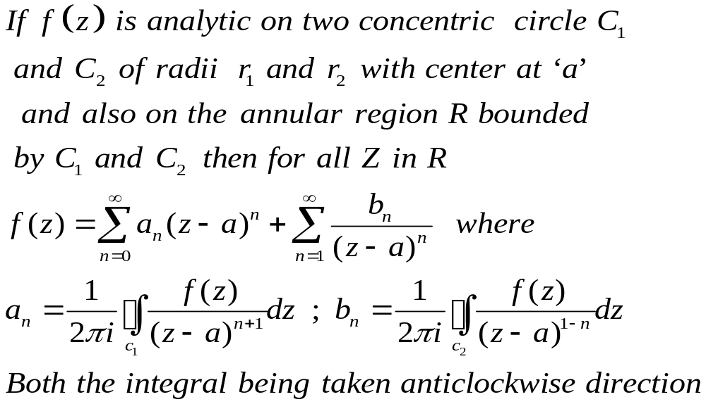
LAURENTS SERIES:

Slide 25
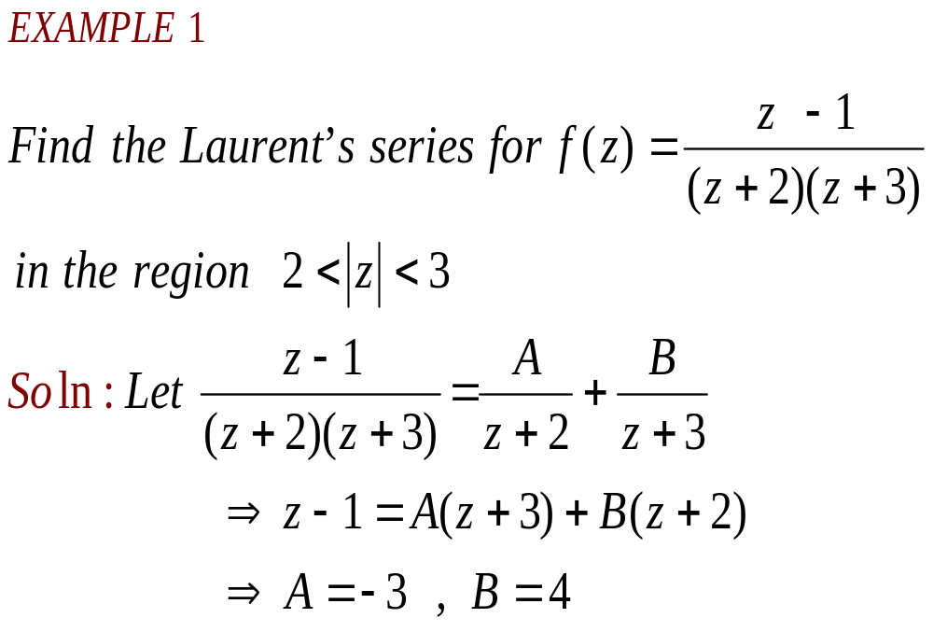

Slide 26
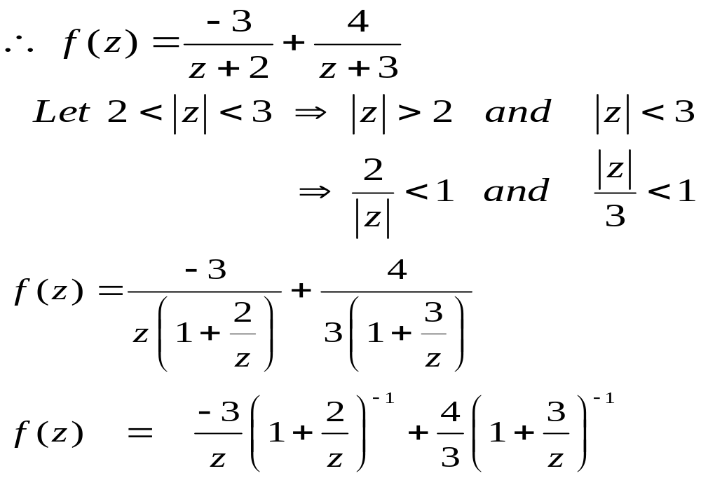

Slide 27
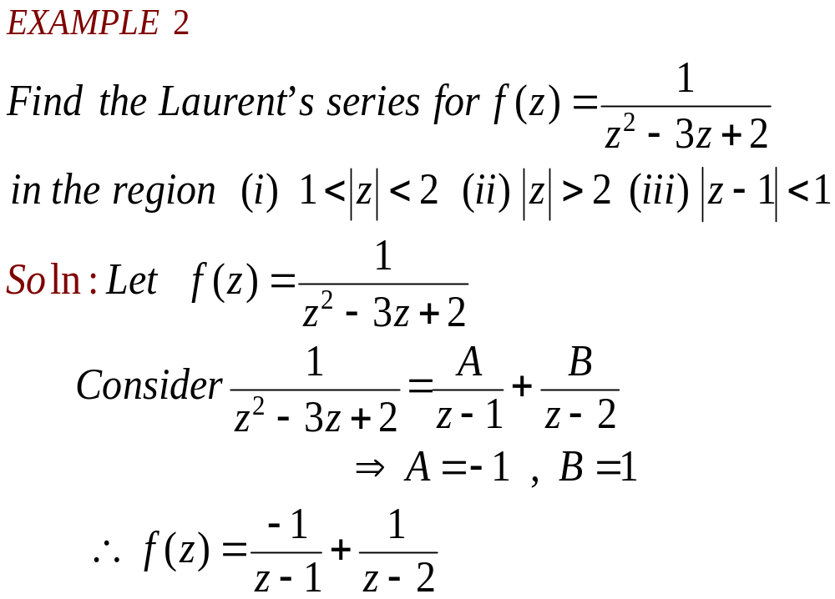

Slide 28
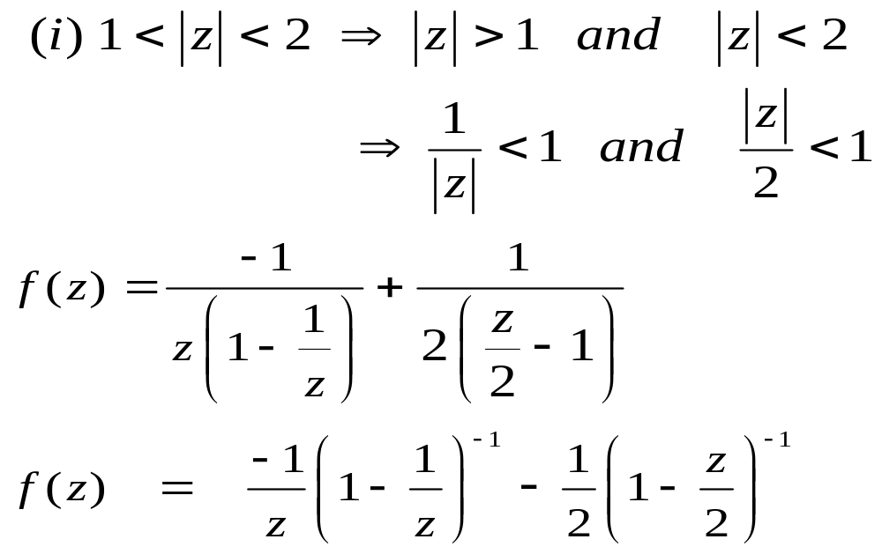

Slide 29
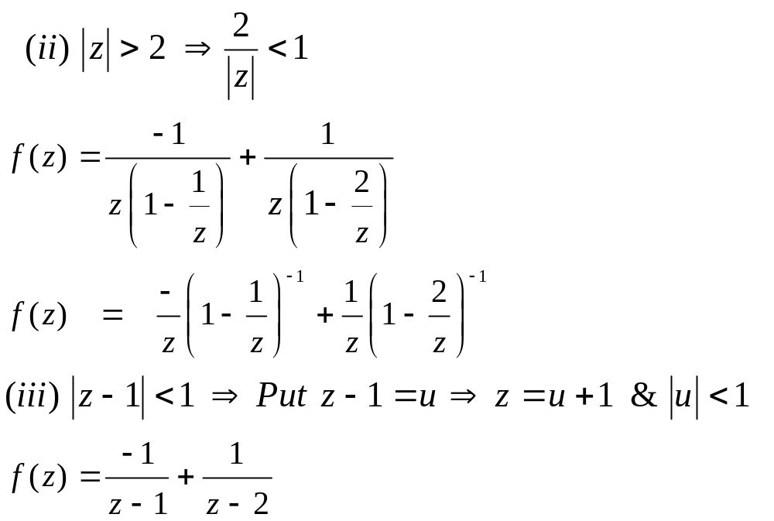

Slide 30
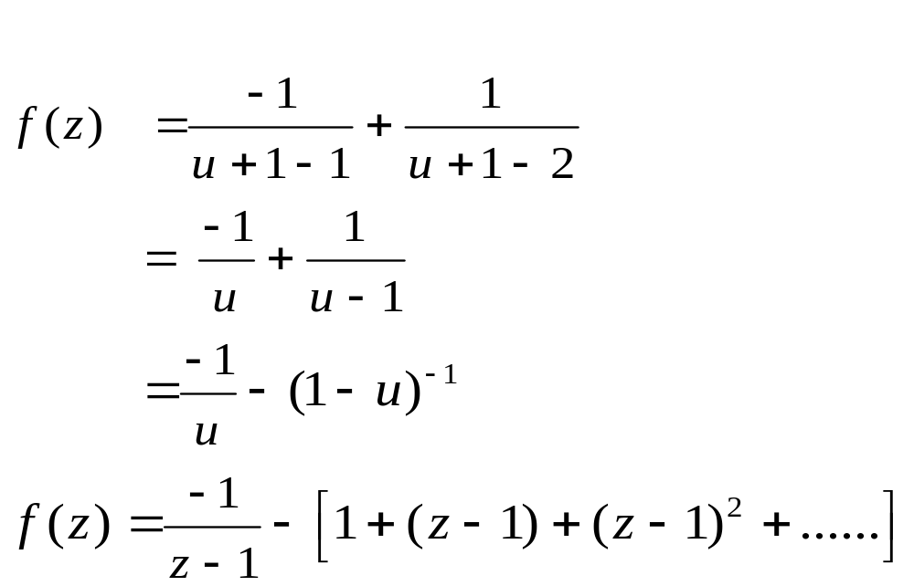

Slide 31
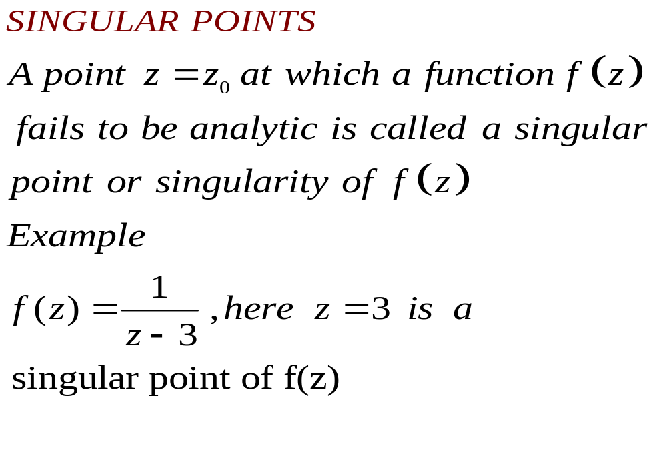

Slide 32

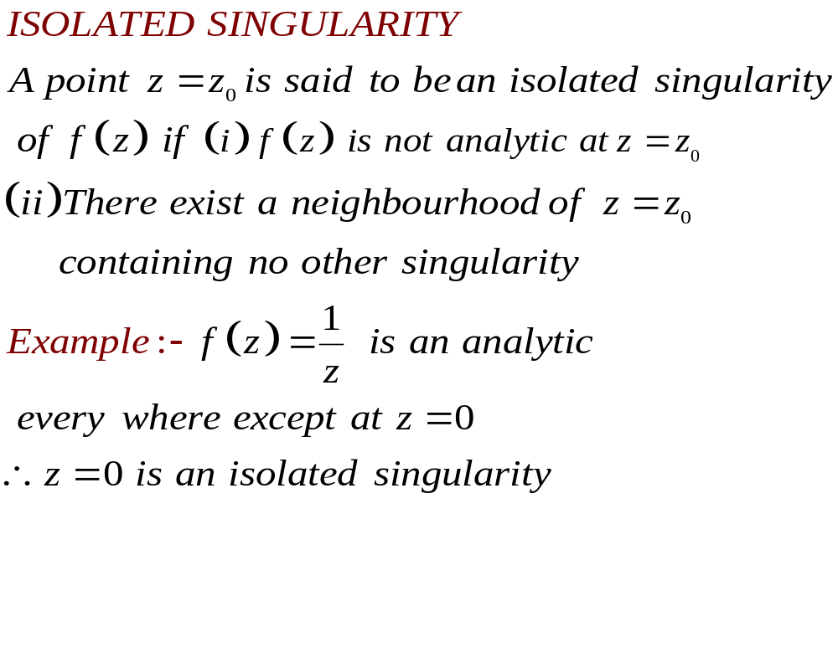

Slide 33
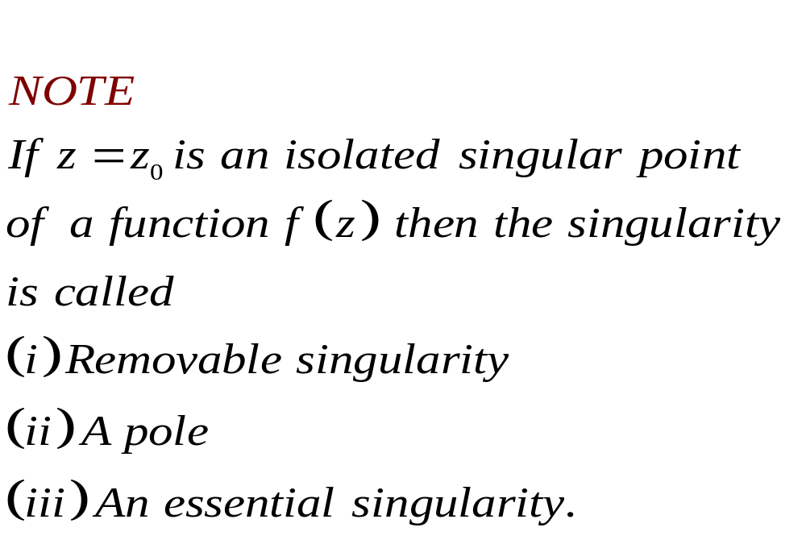

Slide 34
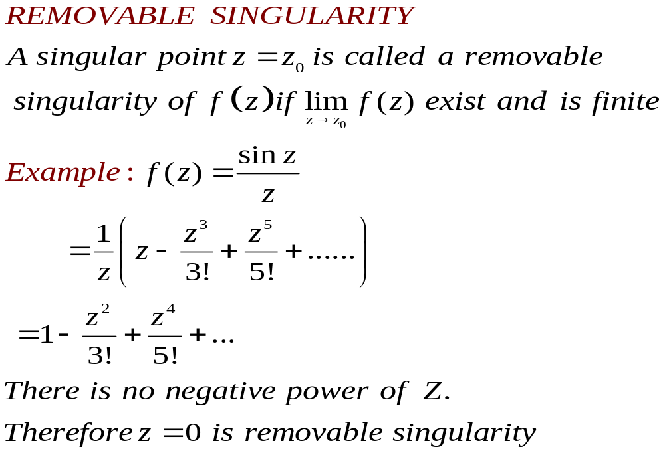

Slide 35
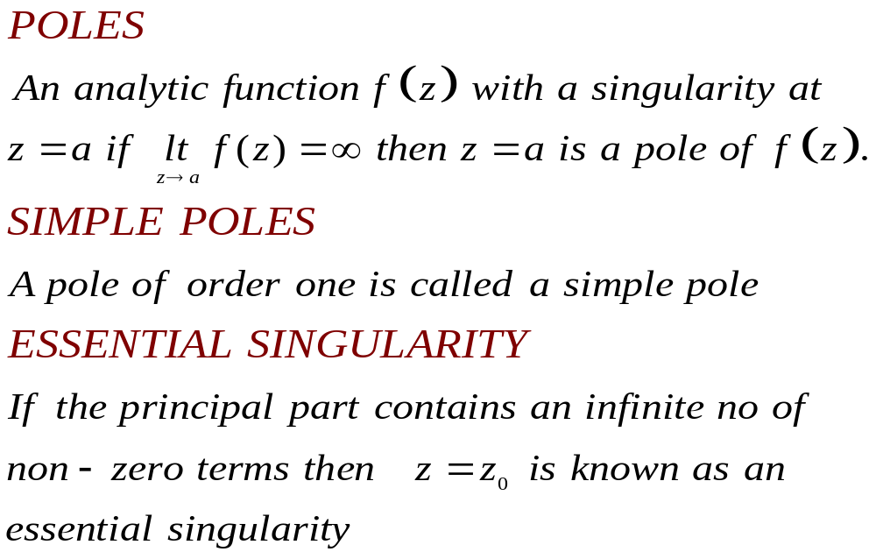

Slide 36
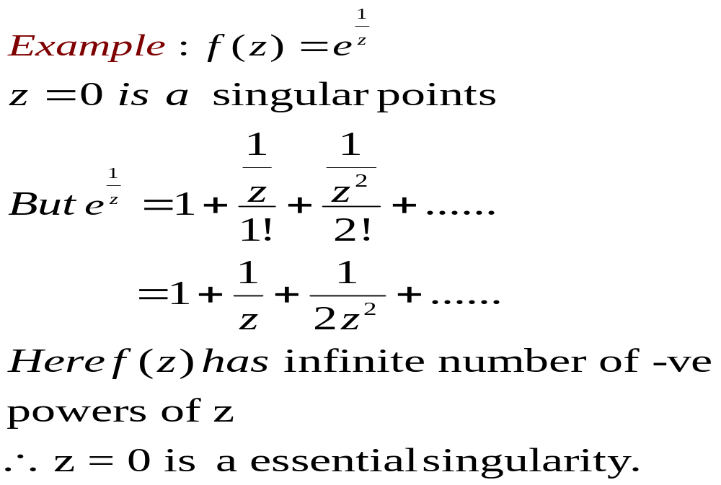

Slide 37
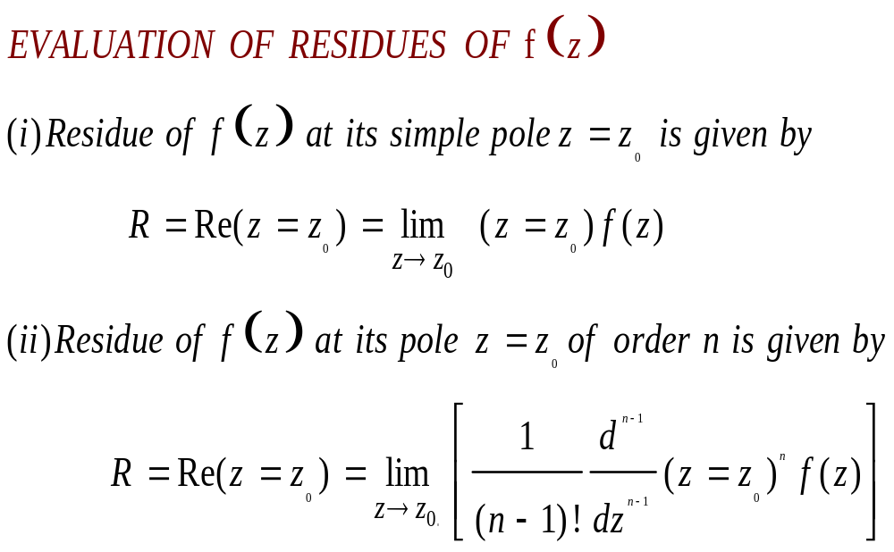

Slide 38
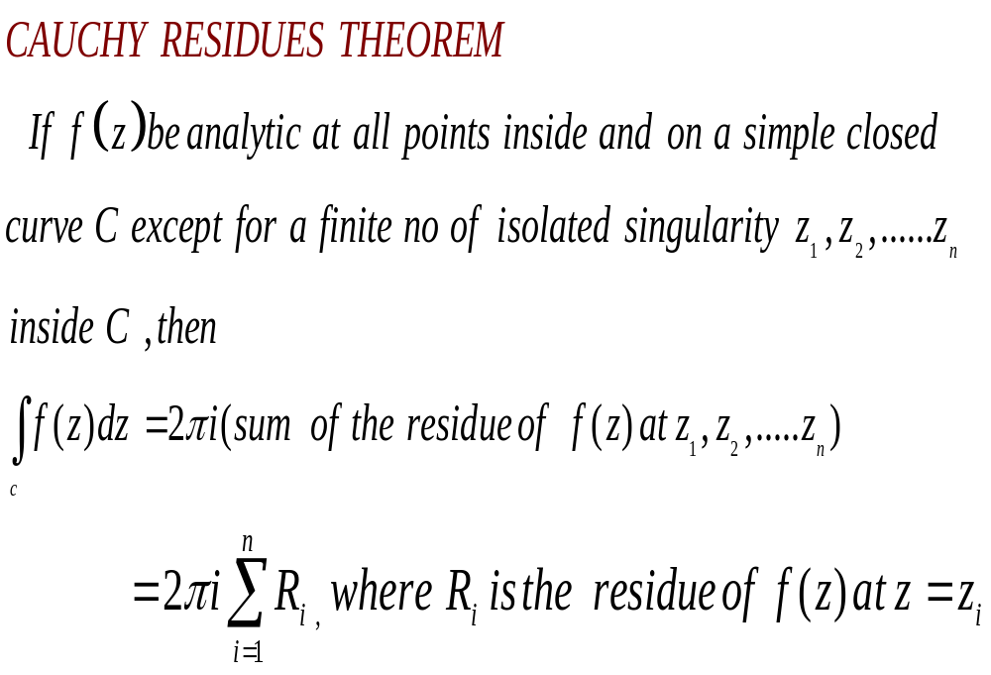

Slide 39
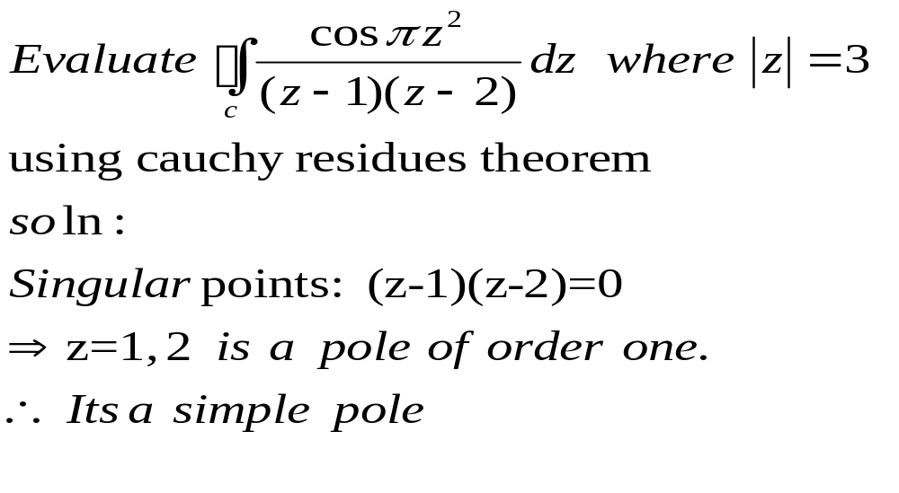
EXAMPLE-1

Slide 40
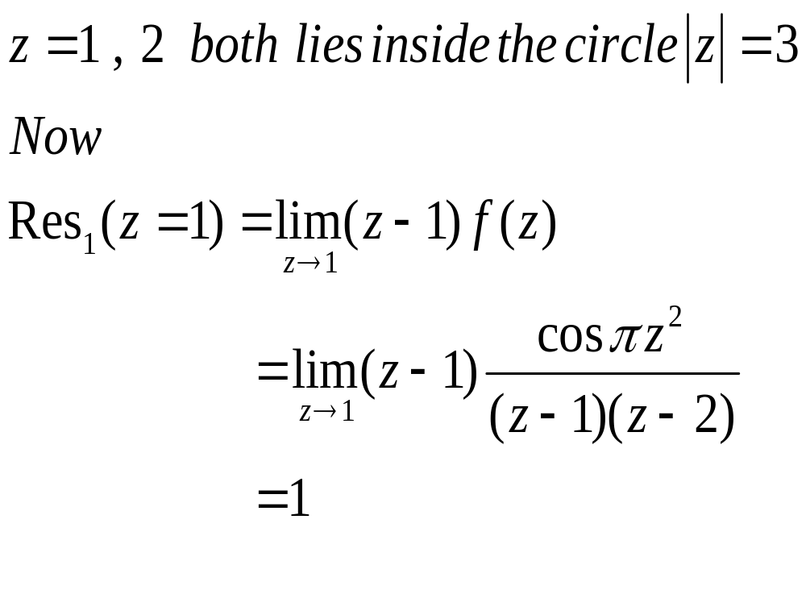
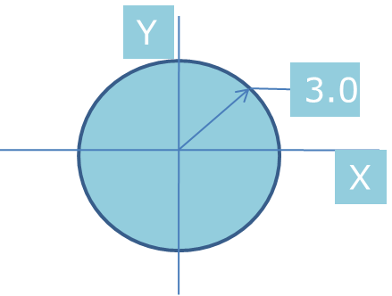

Slide 41
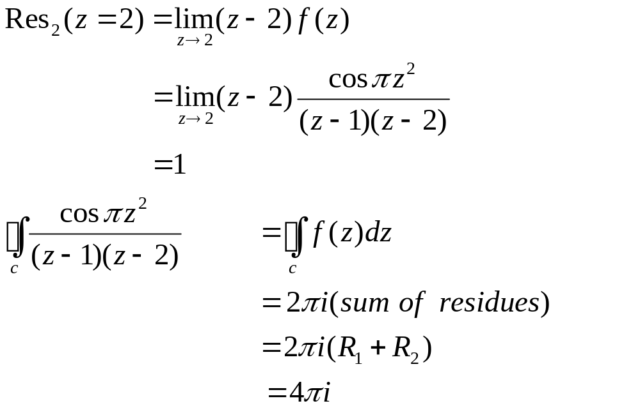

Slide 42
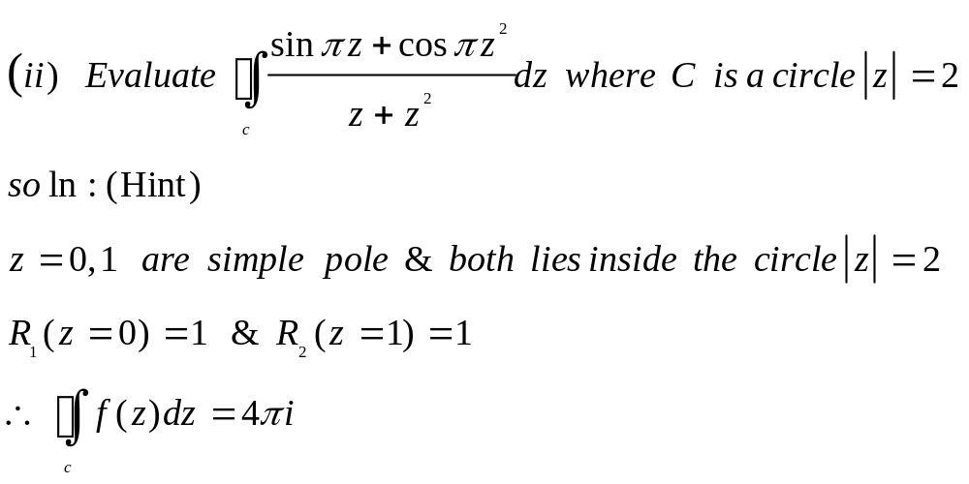
EXAMPLE-2

Slide 43
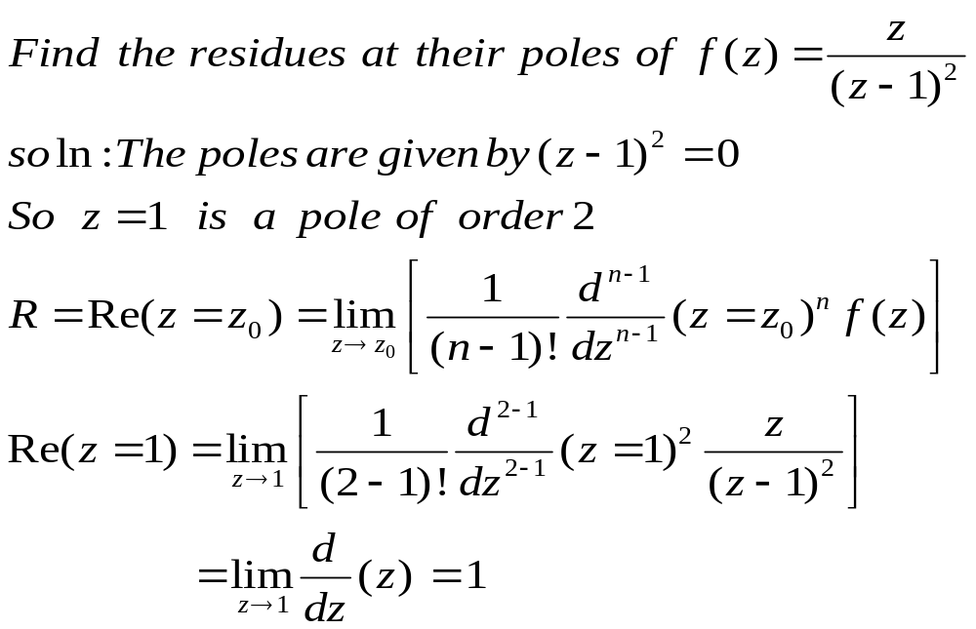
EXAMPLE-3

Slide 44
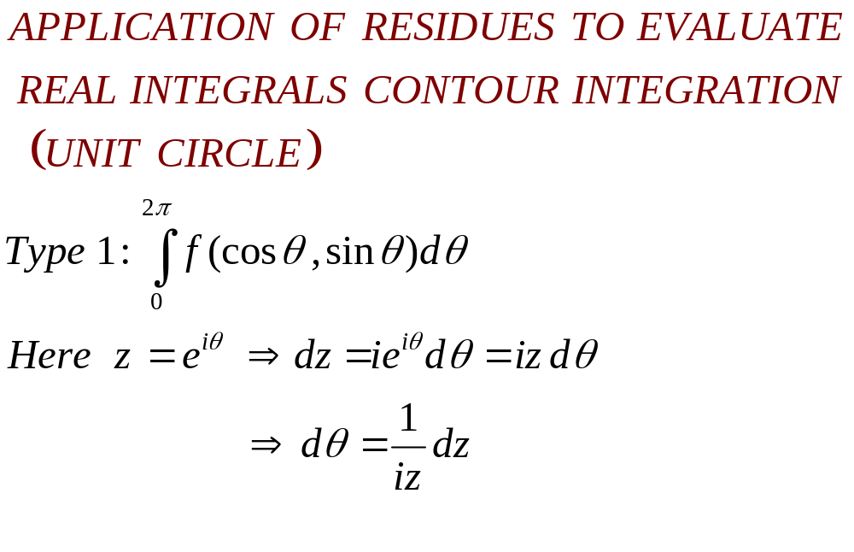

Slide 45
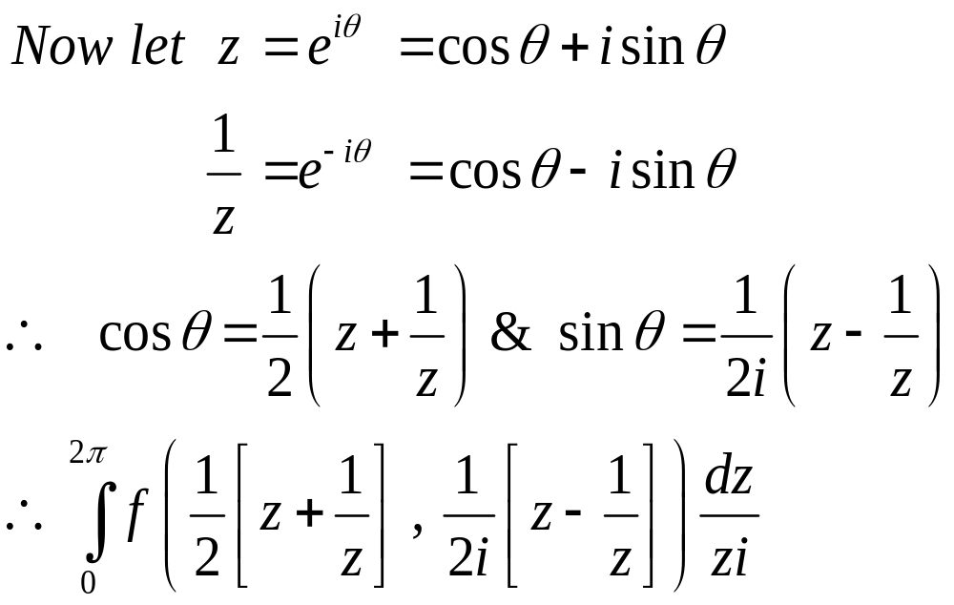

Slide 46
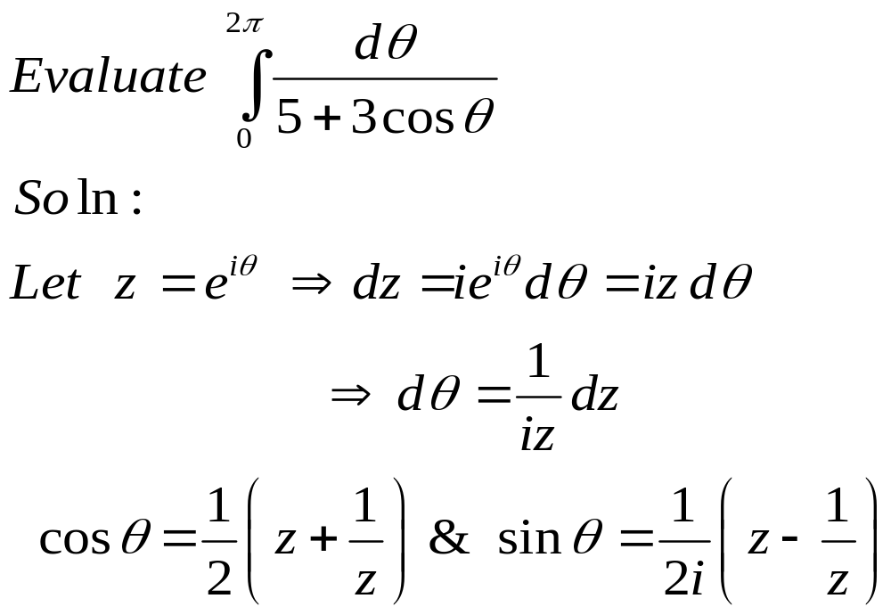
EXAMPLE

Slide 47
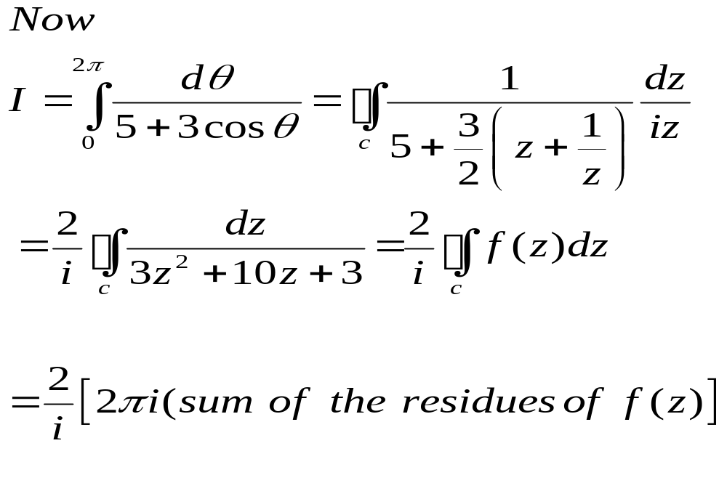

Slide 48


Slide 49






Type II: Improper Integrals of Rational Functions
Evaluate
Let where C is made up (i) : The upper half of the semicircle
taken in the anti-clockwise sense.
(ii) L: The line segment [-R, R]
The singularities of f(z) are given by

Slide 50


is a pole of order 3. here z = ai is a pole of order 3 alone lies inside C.
By Cauchy’s residue theorem,

Slide 51


From (1) we have

Slide 52




On L, z = x, dz = dx, -R≤x≤R
Allow on both sides
By using Cauchy’s lemma,

Slide 53



From (2),
2. Using contour integration, evaluate
Consider where C is made up of
(i) : The upper half of the semi circle taken in the anticlockwise same.

Slide 54



L: The line segment [-R, R]
The singularities of f(z) are given by
which are simple pole. z = ai along lies inside C.
By Cauchy residue theorem,

Slide 55





On L, z = x, dz = dx, -R≤x≤R
Allow on both sides
By using Jordan’s lemma,

Slide 56



Equating the imaginary parts on both sides,
Since the integrand is an even function of x.

Slide 57
Unit V-Completed
*** THANK YOU ***

